Slide 1
Mythbusting Government Procurement
Tags
!-MB-01
Office of Small and Medium Enterprises
Canada.ca/OSME
Notes:
Last updated 2021/03/05

Slide 2
How much does the government buy?
Tags
!-MB-02
Government of Canada is one of the largest buyers of goods and services in Canada
The government spent approximately $23B annually on goods, services, construction and maintenance projects from 2017 to 2020
Awards over 500K contracts and processes close to 2M credit card transactions each year
Notes:
Let’s start by talking about the potential opportunities.
Each year, the Government of Canada spends billions of dollars by awarding hundreds of thousands of contracts and making well over a million direct credit card purchases. This represents a huge potential market.
So why aren’t more smaller Canadian companies taking advantage of these opportunities?
One of the best parts of my job is that I get to engage with the small business community and hear their concerns. When I ask small businesses if they have considered selling to the Government of Canada, here are some of the most common answers I get:
The government isn’t interested in what we sell
The government only buys from big corporations
We are too small to compete
It’s too complicated
Data sources:
PSPC’s Acquisition Information Service (AIS) over the last three fiscal years (FY17-18, FY18-19, and FY19-20), using standard document exclusion for PSPC-AP managed procurement and Purchasing Activity Report (PAR) for total Canadian government procurement statistics. Provided by Business Analytics Services Directorate (BASD), Procurement Business Management Sector (PBMS), Acquisitions Program
Proactive Disclosure of Contracts, ‘Aggregated Total – Contracts $10K and Under’

Slide 3
Myth: The government doesn’t buy from smaller businesses
Tags
!-MB-03
Around 90% of government contracts awarded each year are valued under $25K
Direct purchases from vendors valued under $10K = over $700M
Notes:
So you think you are too small to compete?
If you are talking about the small percentage of contracts for big ticket items that we hear about in the media, then you are probably right. There are only a handful of companies around the globe that can manufacture and sell fighter aircraft.
But actually, the majority of contracts awarded by the Government of Canada are valued under $25,000. Almost all credit card purchases, which are direct purchases from vendors, are valued under $10,000.
And smaller Canadian companies are well positioned to take on these types of contracts and provide the Government of Canada with the majority of goods and services it needs every year.
Data sources:
PSPC’s Acquisition Information Service (AIS) over the last three fiscal years (FY17-18, FY18-19, and FY19-20), using standard document exclusion for PSPC-AP managed procurement and Purchasing Activity Report (PAR) for total Canadian government procurement statistics. Provided by Business Analytics Services Directorate (BASD), Procurement Business Management Sector (PBMS), Acquisitions Program
Proactive Disclosure of Contracts, ‘Aggregated Total – Contracts $10K and Under’

Slide 4
Myth: I’m too small to sell to the government
Tags
!-MB-04
In addition to doing business with large companies, Government of Canada buys from:
Established
local
business
Medium-sized
business
Solopreneur
1
499
Small independent
business
Growing
start-up
Note: Numbers indicate number of employees in the company
Notes:
So you think the Government of Canada only does business with large corporations?
The truth is that the Government of Canada buys more goods and services from micro, small, and medium enterprises than it does from large companies.
Smaller companies vastly outnumber large corporations. Their competitive edge comes from offering a wider range of specialized products and services, and from being local and innovative.
Speaking of being innovative: the federal government has a number of innovation programs, like those offered by Innovative Solutions Canada, that allow start-ups to sell new products directly to the Government of Canada. They get their first sale and the government gets to try cool new tech and other innovative products before anyone else.
Of all contracts managed by PSPC, 52% of total contract value was awarded to smaller businesses in fiscal 2019-20. (Source: Departmental Results Report 2019-20)

Slide 5
Myth: The government doesn’t buy from businesses like mine
Tags
!-MB-05
We believe in inclusive procurement
All suppliers must have an equal chance at doing business with us
Includes:
Green and clean tech
Women-owned and women-led businesses
Under-represented groups
Indigenous peoples
New Canadians
Social enterprises
Notes:
So you think the Government of Canada doesn’t buy from companies like yours?
The government has been working to make it easier for all kinds of suppliers to do business with the federal government, including those that have little to no experience with the process.
It’s been making procurement processes easier, faster and more accessible, so they’re less burdensome for businesses.
It’s been experimenting with pilot projects to increase opportunities for businesses run by groups that haven’t sold as much to government in the past, like businesses owned by women, visible minorities or persons with disabilities, and social enterprises.
It’s encouraging departments to find ways to increase the value of contracts awarded to Indigenous businesses.
It’s expanding opportunities for green goods and services by making environmentally friendly purchasing a focus.

Slide 6
Myth: The government doesn’t buy what I sell
Tags
!-MB-06
The usual commodities
Technology
Military
Property
Professional services
Construction
And so much more…
Catering services
Snow removal and landscaping
Dogs and dog grooming
Clothing
Shower curtains
Notes:
So you think the government doesn’t buy what you sell?
Let’s see if we can separate fact from fiction.
What does the Government of Canada buy? Of course they buy they military equipment, icebreakers, computers, software, and office supplies. But that’s just the tip of the iceberg.
Did you know they also buy:
Food
All types of training
Exercise equipment
Plumbing supplies
Golf carts
Bicycles
Veterinarian and health services
And so much more
It’s a very wide range, and there’s a need for the types of goods and services that smaller businesses sell.

Slide 7
Myth: Government procurement is difficult and time consuming
Tags
!-MB-07
All procurement activities must be open, fair and transparent
Federal laws and regulations as well as Treasury Board of Canada policies guide the Government of Canada’s procurement process
Initiatives to make procurement more accessible:
E-procurement
E-bid submission
15 day payment
Plain language
Reducing barriers to entry
Notes:
So you think the process is complicated?
Ten years ago, I probably would have agreed with you. And it’s true that there are different rules and policies that have to be followed in government procurement.
But a lot has changed. Real progress has been made to improve your experience as a supplier, and to encourage you to participate.
The improvements so far include:
Being able to submit bids electronically for some contracts.
Getting paid faster, in fact there’s an initiative on the go now to pay invoices within 15 days
And there are more improvements ahead to make it easier and faster for suppliers to do business with the Government of Canada. For example:
Contract paperwork is being simplified.
And stay tuned for the government’s new electronic procurement solution, which will move federal procurement online.

Slide 8
Myth: Government procurement is centralized
Tags
!-MB-08
The Government is not a single client
Larger and more complex contracts managed by Public Services and Procurement Canada (PSPC)
100+ departments and agencies do buy their own goods and services
Notes:
So you think government procurement is centralized?
Actually, the Government of Canada has hundreds of departments and agencies, and they operate all across the country, not just in Ottawa. When you think of selling to the Government of Canada, you should think of it as hundreds of potential clients with different needs and in different geographic locations.
Let’s take the RCMP as an example. They have detachments all across the country, even in remote areas. They need a whole range of services, like janitorial services, landscaping, snow removal, the list goes on and on. And that’s just one organization!

Slide 9
Competitive procurement
Tags
!-MB-09
Procurement over $25,000 for goods and $40,000 for services awarded through the solicitation of bids and quotes from potential suppliers
Variety of methods
Tender notice indicates how the government intends to buy the good or service
Notes:
So here is a quick overview of how the procurement process works:
For the purchase of goods over $25,000 and $40,000 for some services, the government will issue a public notice. This is what is known as a tender notice. Tender notices are published on a centralized government hosted website, Buyandsell.gc.ca, which I will talk about in more detail in a moment.
This is a formal process designed to ensure open, fair, and transparent competition for government contracts. Basically, the government lays all of its cards on the table by publishing a document that clearly outlines:
Who has a requirement
What they require
Where and when the goods and/or services are to be delivered
How they intend to pick a winner
Anyone capable of delivering on the requirement and willing to take the time to prepare a bid has a fair shot at winning the contract.

Slide 10
Low dollar value procurement
Tags
!-MB-10
Access
Competition
Fairness
Majority of low dollar contracts are awarded using a competitive process
Non-competitive approaches can be used
Goal: best value for Canadians while enhancing access, competition and fairness to businesses
Suppliers may be identified through networks, research, federal supplier registration systems
Notes:
Contracts for below $25K for goods and below $40K for services are usually awarded using some kind of competitive process. But it’s a much less formal process, likely to be along the lines of requesting "3 quotes” rather than the "35-page tender notice document" approach. The government will identify potential suppliers via supplier lists, industry associations, or even using Google.
For purchases under $10K, the process can be even less formal. Often it can be as simple as a telephone buy or an online purchase.
If you want to tap into this multi-billion dollar market, you need to be proactive and make sure buyers know where to find you, like having an online presence.
Note: You can market your business directly to government buyers. Generally speaking, government buyers can engage with businesses directly for low dollar value procurement of goods up to $25K and of services up to $40K. Over these thresholds, goods are purchased through a competitive process, and services are purchased through prequalified suppliers.

Slide 11
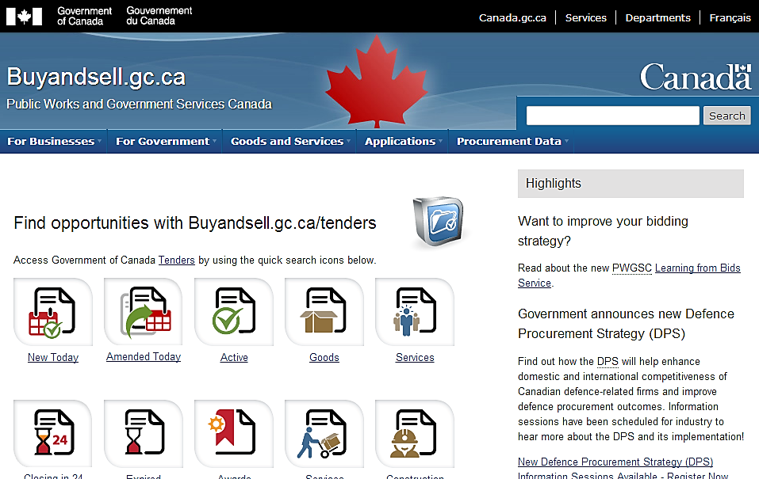
Figure out if selling to the government is right for you
Tags
!-MB-11
Via BuyAndSell.gc.ca
Find out if the Government buys what you sell:
Search your competitors
Search for goods and services that you sell
If you find those, the Government could be a potential client for you.
Notes:
How can you figure out if selling to the government is right for you?
Go to Buyandsell.gc.ca, which is the authoritative source for government procurement information.
Federal departments and agencies use Buyandsell.gc.ca to advertise their requirements.
There are a number of benefits to using Buyandsell.gc.ca:
access is free and you don't have to register
you can search using plain language to find opportunities
you can find previous contracts notices, which gives you an idea of what buyers have bought in the past and can be useful for you as you develop your business strategy.
you can subscribe to receive email notification when new opportunities are published.

Slide 12
Electronic procurement solution (1/2)
Tags
!-DB-48
!-DS-58
!-FO-14
!-SP-39
!-BO-65 !-MB-12
The Government is moving federal procurement online, and changing the way government and suppliers interact to buy and sell goods and services.
CanadaBuys.Canada.ca will gradually replace BuyAndSell.gc.ca.
Registration is open through CanadaBuys.
Notes:
Public Services and Procurement Canada (PSPC) is using SAP Ariba, a web-based tool that allows businesses to view and bid on opportunities with the Government of Canada. All procurement that PSPC manages for the Government of Canada will take place on this tool and businesses will need an account.
CanadaBuys will gradually replace BuyAndSell.gc.ca and bidding will gradually move to SAP Ariba. We are making this transition over time and in phases.
Registration is open through CanadaBuys. For more information, refer to the Getting Started and Resources pages on CanadaBuys. For technical support, contact the EPS service desk through the Support page on CanadaBuys.
Millions of companies around the world use SAP Ariba, so your business may already have an account. If you are unsure if your business already has an account, you can search by business name to verify.
If you already have an account, you will simply need to answer a few additional questions about your business in order to view and bid on Government of Canada tender opportunities.

Slide 13
Electronic procurement solution (2/2)
Tags
!-DB-49
!-DS-59
!-FO-15
!-SP-40
!-BO-66
!-MB-13
During transition, you may be able to bid on some tender opportunities through the electronic procurement solution on the SAP Ariba web-based tool accessible on CanadaBuys.
Each procurement opportunity will clearly detail the delivery method to be used to submit a bid.
Check the Event Calendar for upcoming seminars.
Notes:
During the transition to online procurement, you will be able to bid on some tender opportunities through SAP Ariba, while others will continue to require bid submission through existing methods.
Each procurement opportunity will clearly detail the delivery method to be used to submit a bid. This means that you may need to register in both SAP Ariba and the Supplier Registration Information (SRI) system.
You can sign up for BuyAndSell news (email notifications, Atom/RSS feeds) in order to receive the latest news on procurement and website updates.
Note about following tenders: When an opportunity is posted in Ariba, a static tender notice is published on BuyAndSell.gc.ca containing a link to the posting. The BuyAndSell.gc.ca notice will NOT be updated when amendments or attachments are added to the Ariba posting. You will need to use the notification options within the Ariba system to receive updates about the tender opportunity.
Keep an eye on the BuyAndSell.gc.ca event calendar for upcoming seminars and presentations about CanadaBuys and the transition to online procurement.

Slide 14
Need help? Office of Small and Medium Enterprises
Tags
!-MB-14
Supports smaller businesses understand the procurement process
Provides advice and tips on how to sell to the Government
Works to reduce barriers to ensure fairness in the process
Assist
Inform
Reduce Barriers
Engage
Notes:
The Office of Small and Medium Enterprises is here to help you understand and navigate the procurement process.
Our role is to offer smaller businesses assistance and information on how to sell their goods and services to the Government of Canada.
We also work to make it easier for smaller businesses to bid on federal contracting opportunities, by finding out what stops them from submitting a bid and advising government buyers and policy-makers on the concerns of smaller businesses. And we suggest ways to make tools and processes better so that it’s easier for smaller businesses to compete for contracts.

Slide 15
OSME Services
Tags
!-MB-15
Seminars to help you register your business and find opportunities
One-on-meetings to provide more personalized support for your business
InfoLine 1-800 number for questions related to procurement or the BuyAndSell.gc.ca website
Canada.ca/OSME
Notes:
How can OSME help?
We offer free seminars and webinars and one-on-one sessions to help suppliers understand federal procurement
We operate a 1-800 National Info Line for suppliers who have questions about the procurement process and tools

Slide 16
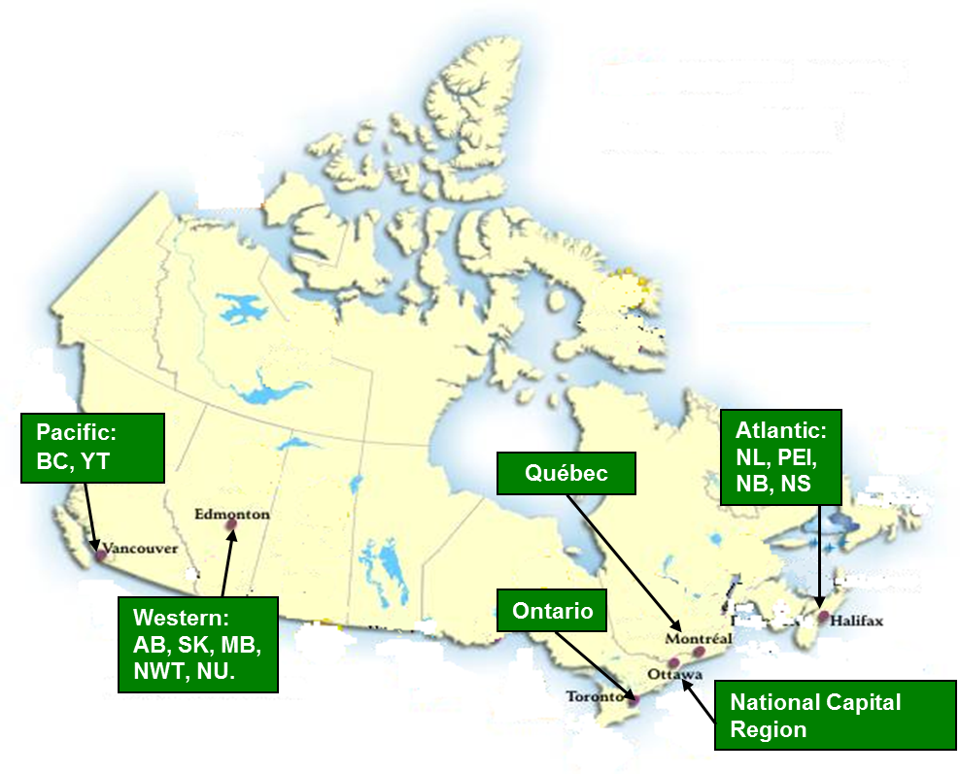
OSME Regional Offices
Tags
!-MB-16
Notes:
OSME has a network of six regional offices and four satellite offices to ensure national coverage. Wherever you are, there is an OSME regional office available to assist you in answering any questions you may have around doing business with the Government of Canada.

Slide 17
Questions?
Tags
!-MB-17

