Slide 1
Doing Business with the Province of British Columbia
Kai Robinson
Director
Strategy and Transformation Branch
Ministry of Citizens’ Services

Slide 2
Agenda
What is the Province of British Columbia?
What is procurement?
What does the Province buy?
How does the Province buy?
Tips for responding to Requests for Proposals
Where to find more information
Questions

Slide 3
Some Caveats…
This is a high-level overview; nuance will be lost.
Conduct your own due-diligence to ensure you understand the process and your obligations.

Slide 4
What is the Province of British Columbia?

Slide 5
What is the Province of British Columbia?
Ministries
Central Agencies
Crown Corporations
Independent boards, commissions & tribunals
20 Ministries
13 Central Agencies
29 Crown Corporations
200+ Independent boards, commissions & tribunals
https://www2.gov.bc.ca/gov/content/governments/organizational-structure/ministries-organizations

Slide 6
What is the Province of British Columbia?
Ministries
Central Agencies
Crown Corporations
Independent boards, commissions & tribunals
>
$6 Billion of Goods, Services, and Construction Procured Annually

Slide 7
What is the Province of British Columbia?
Ministries
Central Agencies
Crown Corporations
Independent boards, commissions & tribunals
We’ll be talking mostly about ministries today…

Slide 8
What is procurement?

Slide 9
What is Procurement?
Procurement is:
The process by which government acquires goods, services, and construction from the vendor marketplace
A critical tool for the delivery of government services and fulfilling mandate objectives

Slide 10
What does the Province buy?

Slide 11
What does the Province buy?
Road Construction and Maintenance
Bridge Building
Infrastructure Projects
Market Research and Development
Food Inspection
Business Development
Studies
Greenhouse Gas Offsets
Environmental Remediation
Engineering
Aviation Services
Geographic Information System (GIS) Data and Analysis
Wildfire-related Goods and Services
And more…

Slide 12
What does the Province buy?
Instructional Designers
Illustrators and Graphic Designers
Photographers and Videographers
Skills Training Program Delivery
Private Training Inspectors
Human Resource Consulting
Grant Administration Services
And more…

Slide 13
What does the Province buy?
Office of the Chief Information Officer
ServiceBC
Government Digital Experience
Procurement and Supply Division
Real Property Division
Corporate Services Division

Slide 14
What does the Province buy?
Office of the Chief Information Officer
- Workstations and support, network, software…
ServiceBC
- Contact centre services, ServiceBC locations…
Government Digital Experience
- Surveys, UX analysis, web development…
Procurement and Supply Division
- Office supplies, uniforms, pharmaceuticals, printing, Corporate Supply Arrangements…
Real Property Division
- Construction, facility management, furniture…
Corporate Services Division
- Studies, analysis, HR, financial analysis, planning…

Slide 15
What does the Province buy?
Transcription services, defibrillators, air tankers, rental vehicles, training delivery, curriculum development, anti-virus software, business plan writing, youth program delivery, market development program delivery, supervisory skills training delivery, HR resourcing benchmarking, financial audit services, real estate appraisals, real estate brokerage, refugee support services, English as a second language training, surveying, event management, utility data management, server colocation, video conferencing, supported independent living, library statistics collection and reporting, bullying prevention, writing services, public legal education, construction skills training delivery, business metadata services, electronic survey services, application management services, anti-virus software, network maintenance, research, food industry report writing, project management services, online directories, food traceability advisors, telecommunications regulatory affairs consulting, craft beer marketing strategy development, export guide development, market analysis, hazardous materials abatement and demolition services, facility management services

Slide 16
What does the Province buy?
In short…
Whatever it is there’s a good chance government buys it

Slide 17
How does the Province buy?

Slide 18
How does the Province buy?
In a fair, open, and transparent manner
Using competitive processes wherever possible
Optimizing value for money
Consolidating spend on common requirements
Complying with federal and provincial laws and regulations as well as various trade agreements

Slide 19
How does the Province buy?
https://www.bcbid.gov.bc.ca/

Slide 20
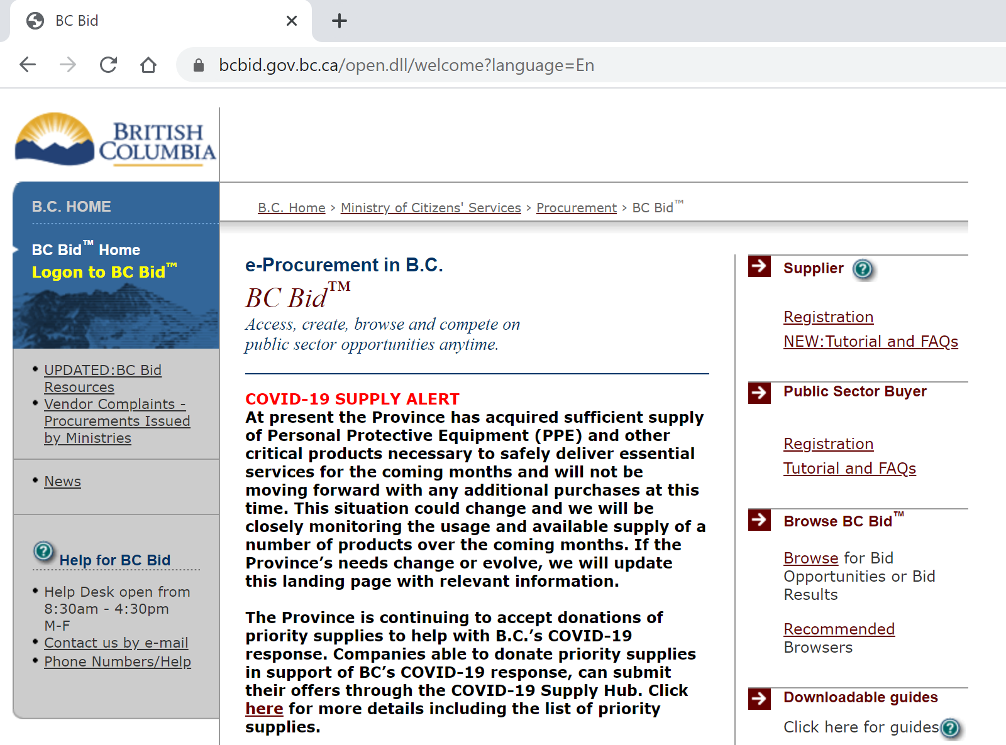

Slide 22
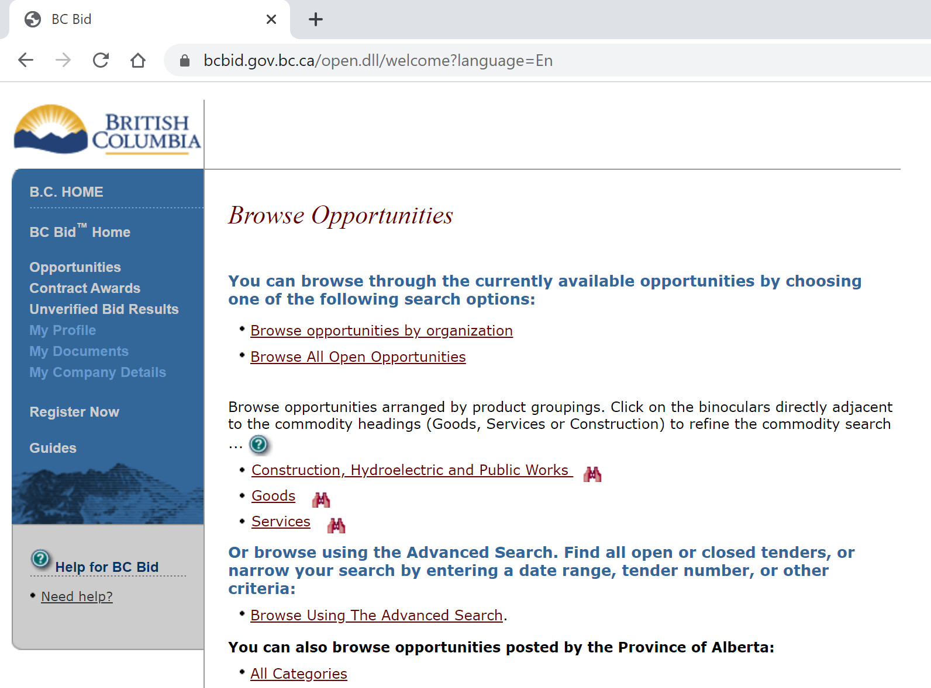

Slide 23
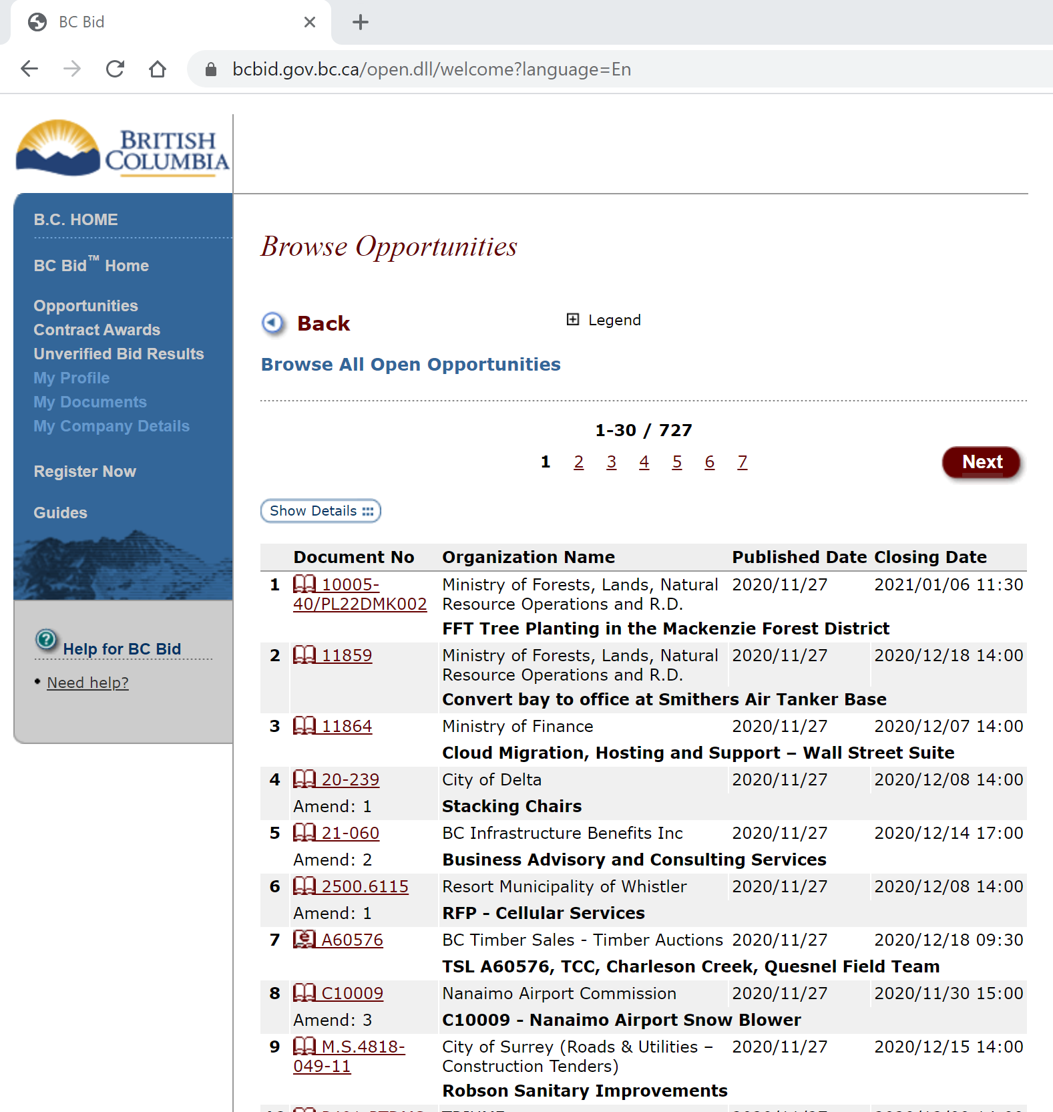

Slide 27
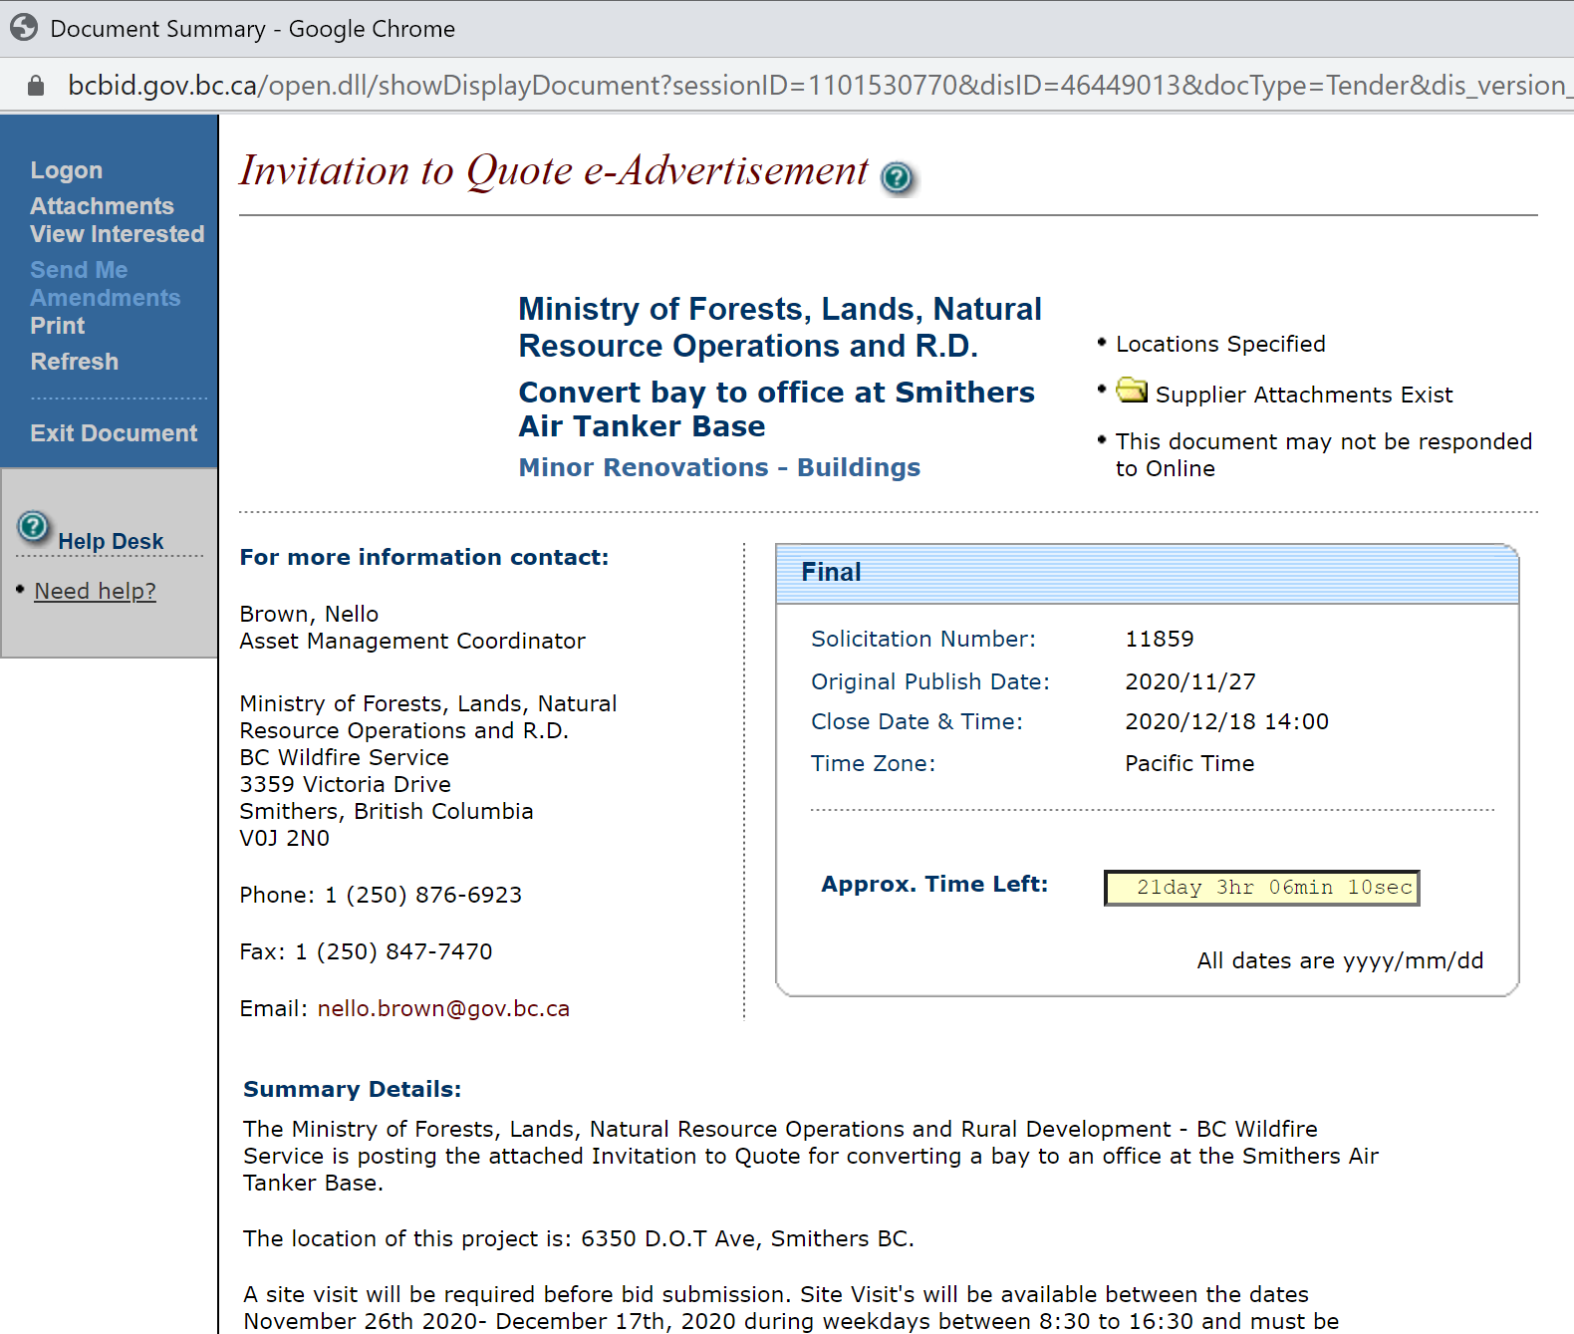

Slide 29
Common Posting Types on BC Bid
RFI = Request for Information
RFEI = Request for Expression of Interest
NTV = Notice to Vendors
NOPP = Notice of Planned Procurement
RFQ = Request for Qualifications
RSO = Request for Standing Offer
RSA = Request for Standing Arrangement
RCSA = Request for Corporate Supply Arrangement
ITQ = Invitation to Quote
ITT = Invitation to Tender
RFP = Request for Proposals
SRFP = Short-Form Request for Proposals
NOI = Notice of Intent

Slide 30
Common Posting Types on BC Bid
RFI = Request for Information
RFEI = Request for Expression of Interest
NTV = Notice to Vendors
NOPP = Notice of Planned Procurement
RFQ = Request for Qualifications
RSO = Request for Standing Offer
RSA = Request for Standing Arrangement
RCSA = Request for Corporate Supply Arrangement
ITQ = Invitation to Quote
ITT = Invitation to Tender
RFP = Request for Proposals
SRFP = Short-Form Request for Proposals
NOI = Notice of Intent
Information Gathering

Slide 31
Common Posting Types on BC Bid
RFI = Request for Information
RFEI = Request for Expression of Interest
NTV = Notice to Vendors
NOPP = Notice of Planned Procurement
RFQ = Request for Qualifications
RSO = Request for Standing Offer
RSA = Request for Standing Arrangement
RCSA = Request for Corporate Supply Arrangement
ITQ = Invitation to Quote
ITT = Invitation to Tender
RFP = Request for Proposals
SRFP = Short-Form Request for Proposals
NOI = Notice of Intent
Information Gathering
Communications to Vendors

Slide 32
Common Posting Types on BC Bid
RFI = Request for Information
RFEI = Request for Expression of Interest
NTV = Notice to Vendors
NOPP = Notice of Planned Procurement
RFQ = Request for Qualifications
RSO = Request for Standing Offer
RSA = Request for Standing Arrangement
RCSA = Request for Corporate Supply Arrangement
ITQ = Invitation to Quote
ITT = Invitation to Tender
RFP = Request for Proposals
SRFP = Short-Form Request for Proposals
NOI = Notice of Intent
Information Gathering
Communications to Vendors
Pre-Qualification for one or more Procurements

Slide 33
Common Posting Types on BC Bid
RFI = Request for Information
RFEI = Request for Expression of Interest
NTV = Notice to Vendors
NOPP = Notice of Planned Procurement
RFQ = Request for Qualifications
RSO = Request for Standing Offer
RSA = Request for Standing Arrangement
RCSA = Request for Corporate Supply Arrangement
ITQ = Invitation to Quote
ITT = Invitation to Tender
RFP = Request for Proposals
SRFP = Short-Form Request for Proposals
NOI = Notice of Intent
Information Gathering
Communications to Vendors
Pre-Qualification for one or more Procurements
Creation of an on-going Offer or Arrangement

Slide 34
Common Posting Types on BC Bid
RFI = Request for Information
RFEI = Request for Expression of Interest
NTV = Notice to Vendors
NOPP = Notice of Planned Procurement
RFQ = Request for Qualifications
RSO = Request for Standing Offer
RSA = Request for Standing Arrangement
RCSA = Request for Corporate Supply Arrangement
ITQ = Invitation to Quote
ITT = Invitation to Tender
RFP = Request for Proposals
SRFP = Short-Form Request for Proposals
NOI = Notice of Intent
Information Gathering
Communications to Vendors
Pre-Qualification for one or more Procurements
Creation of an on-going Offer or Arrangement
Competitive Procurement

Slide 35
Common Posting Types on BC Bid
RFI = Request for Information
RFEI = Request for Expression of Interest
NTV = Notice to Vendors
NOPP = Notice of Planned Procurement
RFQ = Request for Qualifications
RSO = Request for Standing Offer
RSA = Request for Standing Arrangement
RCSA = Request for Corporate Supply Arrangement
ITQ = Invitation to Quote
ITT = Invitation to Tender
RFP = Request for Proposals
SRFP = Short-Form Request for Proposals
NOI = Notice of Intent
Information Gathering
Communications to Vendors
Pre-Qualification for one or more Procurements
Creation of an on-going Offer or Arrangement
Competitive Procurement
Intention to Direct Award

Slide 39
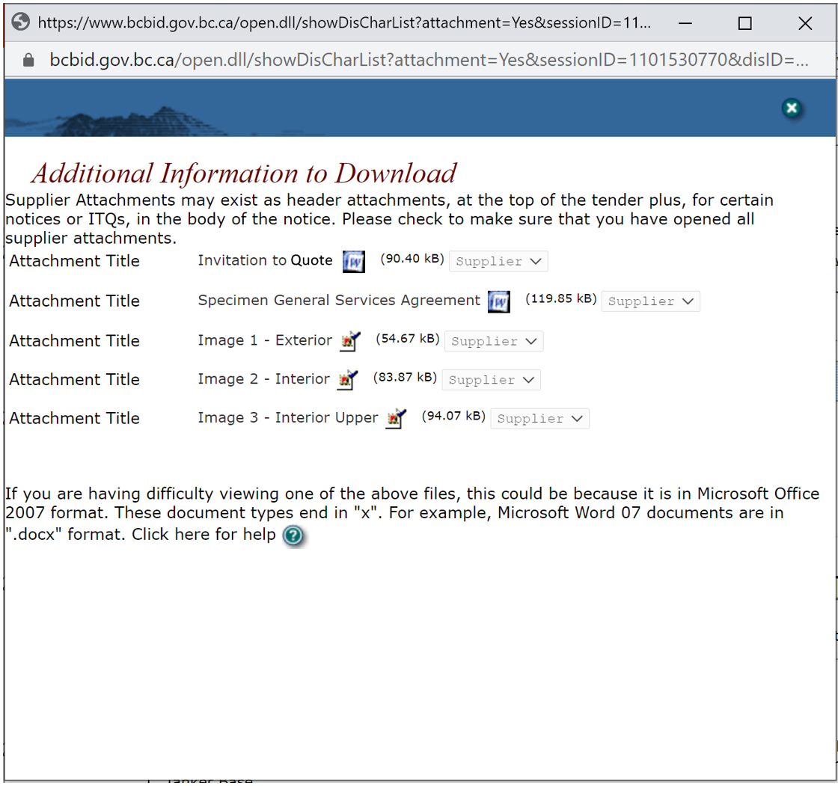

Slide 44
Registering on BC Bid
Document download is free
2 Subscription options
Email Notification ONLY - $100 per year
e-Bidding - $150 per year for ability to submit bids through BC Bid
Pay for both to have full access - $250 per year

Slide 46
How does the Province buy?
1
Supply Arrangements
2
Competitive Processes
3
Direct Awards

Slide 47
How does the Province buy?
1
Supply Arrangements
Corporate Supply Arrangements (CSA)
Centrally created and managed. If a ministry’s need can be satisfied through a CSA, the CSA must be used.
Standing Offers (SO)
A formal offer from a vendor which a ministry can accept as needed.
Standing Arrangements (SA)
Contracts which a ministry can ‘draw-down’ on as, if, and when required.
BC Bid is used to establish CSAs, SOs, and SAs
2
Competitive Processes
3
Direct Awards

Slide 48
Corporate Supply Arrangements
Accommodation Listings
Employee Business Travel Accommodation Listings
Hotel Accommodation for Medical Travellers
COVID-19 Relief Rate
Advertising and Marketing Services
Airlines
Armoured Car Services CSA
Asset Disposal Services
Audio Visual Goods and Services CSA
Banners
Brochures (printed)
Cell Phones, Mobile Devices and Internet Data Sticks
Citizen Engagement Services
Collaboration Services
Communications Services
Commercial Card Services
Computer Hardware
Computer Software
Concrete Barriers CSA
Concrete Toilet Buildings CSA (Wheelchair accessible)
Continuous Improvement
Courier Services
Data Centre Services
Digital Certificate Service
Digital Publishing
Document Scanning & Data Capture
Duplication Services (of CD, DVD & USB Sticks)
Electric Vehicle Charging Stations CSA
Employee Household Relocation Moving Services
Employee Safety Monitoring Services CSA
Energy Study
Event Management
Executive Coaching CSA
Facilitation Services CSA
Furniture
Garbage Receptacles CSA
Graphic Design Services
IM/IT Consultant Resources (Flextrack)
IM/IT Security Services
Industry Intelligence
Learning and Development Services CSA (formerly Training and Curriculum Development Services)
LED Street Light Luminaires CSA
Mobility Devices and Other Durable Medical Equipment
Office Supplies
Photocopiers
Pipe
Playground Equipment CSA
Printing
Radios CSA
Seedling Fertilizer CSA
Temporary Help Services CSA
Tires and Tubes CSA
Translation and Interpretation Services CSA
Uninterruptible Power Supply CSA – Batteries
Vehicle Rentals
Vehicle Servicing
Web Writing Services
Useful Links
List of all CSAs
CSA FAQs

Slide 49
How does the Province buy?
1
Supply Arrangements
Generally, the bigger the procurement, the more broadly it is competed.
Depending on the anticipated dollar-value of the procurement, competitive processes might be competed:
amongst a small group of vendors; or
through open public competitions on BC Bid.
2
Competitive Processes
3
Direct Awards

Slide 50
Competitive Processes
<$100k
<$75k
<$25k
<$25k
<$25k
Competed to the Extent Reasonable and Cost-effective
<$5k
<$5k
Goods
Services
Construction

Slide 51
Competitive Processes
<$100k
$25k ⇨ $100k
<$75k
$25k ⇨ $75k
At least three quotes obtained
<$25k
<$25k
<$25k
Competed to the Extent Reasonable and Cost-effective
<$5k
<$5k
Goods
Services
Construction

Slide 52
Competitive Processes
>$100k
Posted on BC Bid
<$100k
>$75k
$25k ⇨ $100k
<$75k
$25k ⇨ $75k
At least three quotes obtained
>$5k
<$25k
<$25k
<$25k
Competed to the Extent Reasonable and Cost-effective
<$5k
<$5k
Goods
Services
Construction

Slide 53
How does the Province buy?
1
Supply Arrangements
Contracts may be negotiated and directly awarded where one of the following exceptional conditions applies:
the contract is with another government organization;
the ministry can strictly prove that only one contractor is qualified, or is available
an unforeseeable emergency exists and the goods, services or construction could not be obtained in time by means of a competitive process;
a competitive process would interfere with a ministry's ability to maintain security or order or to protect human, animal or plant life or health; or
the acquisition is of a confidential or privileged nature and disclosure through an open bidding process could reasonably be expected to compromise government confidentiality, cause economic disruption or be contrary to the public interest.
2
Competitive Processes
3
Direct Awards

Slide 54
Notice of Intent
Posted on BC Bid when a ministry believes, but can’t strictly prove, that only one vendor is qualified or available to deliver particular goods, services, or construction.
Includes a mechanism for qualified and available vendors to object to the direct award.

Slide 55
Tips for responding to Requests for Proposals

Slide 56
Common Posting Types on BC Bid
RFI = Request for Information
RFEI = Request for Expression of Interest
NTV = Notice to Vendors
NOPP = Notice of Planned Procurement
RFQ = Request for Qualifications
RSO = Request for Standing Offer
RSA = Request for Standing Arrangement
RCSA = Request for Corporate Supply Arrangement
ITQ = Invitation to Quote
ITT = Invitation to Tender
RFP = Request for Proposals
SRFP = Short-Form Request for Proposals
NOI = Notice of Intent
Information Gathering
Communications to Vendors
Pre-Qualification for one or more Procurements
Creation of an on-going Offer or Arrangement
Competitive Procurement
Intention to Direct Award

Slide 57
Common Posting Types on BC Bid
RFI = Request for Information
RFEI = Request for Expression of Interest
NTV = Notice to Vendors
NOPP = Notice of Planned Procurement
RFQ = Request for Qualifications
RSO = Request for Standing Offer
RSA = Request for Standing Arrangement
RCSA = Request for Corporate Supply Arrangement
ITQ = Invitation to Quote
ITT = Invitation to Tender
RFP = Request for Proposals
SRFP = Short-Form Request for Proposals
NOI = Notice of Intent
Information Gathering
Communications to Vendors
Pre-Qualification for one or more Procurements
Creation of an on-going Offer or Arrangement
Competitive Procurement
Intention to Direct Award

Slide 58
Common Posting Types on BC Bid
RFI = Request for Information
RFEI = Request for Expression of Interest
NTV = Notice to Vendors
NOPP = Notice of Planned Procurement
RFQ = Request for Qualifications
RSO = Request for Standing Offer
RSA = Request for Standing Arrangement
RCSA = Request for Corporate Supply Arrangement
ITQ = Invitation to Quote
ITT = Invitation to Tender
RFP = Request for Proposals
SRFP = Short-Form Request for Proposals
NOI = Notice of Intent
Information Gathering
Communications to Vendors
Pre-Qualification for one or more Procurements
Creation of an on-going Offer or Arrangement
Contractor chosen based on price
Intention to Direct Award

Slide 59
Common Posting Types on BC Bid
RFI = Request for Information
RFEI = Request for Expression of Interest
NTV = Notice to Vendors
NOPP = Notice of Planned Procurement
RFQ = Request for Qualifications
RSO = Request for Standing Offer
RSA = Request for Standing Arrangement
RCSA = Request for Corporate Supply Arrangement
ITQ = Invitation to Quote
ITT = Invitation to Tender
RFP = Request for Proposals
SRFP = Short-Form Request for Proposals
NOI = Notice of Intent
Information Gathering
Communications to Vendors
Pre-Qualification for one or more Procurements
Creation of an on-going Offer or Arrangement
Contractor chosen based on price + other criteria
Intention to Direct Award

Slide 60
But first, some more caveats…
There is no secret formula for success
Every procurement is different
You won’t win them all

Slide 61
Tips for responding to Requests for Proposals
1
Understand the RFP
4
Think like an Evaluator
2
3
Follow Directions
Watch your Language

Slide 62
Tips for responding to Requests for Proposals
1
Understand the RFP
4
Think like an Evaluator
2
3
Follow Directions
Watch your Language
Thoroughly read the entire RFP including all appendices any attached contract
If still unclear, ask
Don’t make assumptions
Understand your Contract “A” obligations

Slide 63
Tips for responding to Requests for Proposals
1
Understand the RFP
4
Think like an Evaluator
2
3
Follow Directions
Watch your Language
Look for directions about the format of the response
Look for “Response Guidelines”
Use any templates provided
Provide all of the information requested
Sign the “Confirmation Of Proponent’s Intent To Be Bound”
Meet all mandatory criteria…

Slide 64
Types of Criteria
Mandatory Criteria
Desirable Criteria
A mandatory criterion is one that must be met in order for your submission to be considered.
If your submission doesn’t meet a mandatory criterion, it will be rejected
Mandatories are indicated by the word “must”.
A desirable criterion is one that should be met, but is not required to be met.
If your submission does not address a desirable, it will be evaluated but will not score as well as one that does address the desirable.
Desirable criteria are indicated by the word “should”

Slide 65
Tips for responding to Requests for Proposals
1
Understand the RFP
4
Think like an Evaluator
2
3
Follow Directions
Watch your Language
Be precise and specific
Quantify things whenever possible
More doesn’t necessarily mean better
Avoid ambiguity and generalities
Language IS important (“Will” vs. “Could”)
Write as though the evaluators have never heard of you

Slide 66
Tips for responding to Requests for Proposals
1
Understand the RFP
4
Think like an Evaluator
2
3
Follow Directions
Watch your Language
Don’t make evaluators dig for information
Don’t include marketing material unless requested
Looks for lists of requirements
Evaluate your own proposal
Request a debriefing

Slide 67
Where to find more Information?

Slide 68
https://www2.gov.bc.ca/gov/content/bc-bid-resources

Slide 71
For Vendors…
How to use BC Bid for Vendors
Respond to Opportunities
Contract Award
Vendor Concerns and Complaints
Learning and Supports

Slide 73
Questions?

Slide 74
Doing Business with the Province of British Columbia
Kai Robinson
Director
Strategy and Transformation Branch
Ministry of Citizens’ Services
Kai.Robinson@gov.bc.ca

