Slide 1
Doing Business with the Government of Alberta
Fran Seary, Procurement Services, Service Alberta
March 18, 2021

Slide 2
Agenda
What does the Government of AB Buy?
Who Does the Buying?
How does the Government of AB Buy?
What can you Do?
Questions?

Slide 3
What does the Government of Alberta Buy?

Slide 4
What does the Government of Alberta Buy?
Goods
such as office equipment, firewood, jet fuel and many other supplies that are used to run the province.
Services
such as information management, printing, community services, and atmospheric monitoring.
Construction
such as schools, roads, power lines, and hospitals.

Slide 5
Average Spend
Commodity
Goods
Services
Construction
$575 Million
$1.75 Billion
$2.75 Billion

Slide 6
Who Buys?

Slide 7
Who does the Buying?
Goods:
Under $10,000 Departments purchase themselves
Over $10,000 Procurement Services within Service Alberta
Services
Departments procure the services they need provided they do not have a goods component over $10,000

Slide 8
Who does the Buying?
Construction:
AB Infrastructure & AB Transportation
Other departments

Slide 9
How does the Government of Alberta Buy?

Slide 10
Let’s Talk About Trade Agreements
WTO GPA – World Trade Organization Agreement on Government Procurement
CPTPP – Comprehensive and Progressive Agreement for Trans-Pacific Partnership
CETA – Canada European Union Comprehensive and Economic Trade Agreement
CFTA – Canadian Free Trade Agreement
NWPTA – New West Partnership Trade Agreement

Slide 11
Trade Agreement Thresholds
*Includes any corporation or entity owned/controlled by a MASH entity.
**Includes Crown Corporations, Commercial Enterprises, and other entities owned/controlled by the Party (GoA) through ownership interest.
FOR CETA ONLY: Crown Corporations also includes corporations or entities owned or controlled by a regional, local, district or other form of municipal government.
***WTO GPA, CPTPP & CETA thresholds are based on SDR (Special Drawing Rights) and are recalculated every two years. CFTA is also recalculated every two years.

Slide 12
The Government of Alberta uses competitive bid process to obtain Goods, Services and Construction

Slide 13
Different Methods for Buying
Request for Proposals (RFP)
For Goods, Services and Construction opportunities where solutions may vary and/or complex; typically awarded based on overall best value
Request for Quotes (RFQ)
For Goods where the marketplace is well-established and understood and specifications are known; typically awarded based on lowest price

Slide 14
Different Methods for Buying cont’d
Pre-Qualification Requests (PQR)
A list of pre-qualified suppliers is established, and the final purchase is awarded utilizing a secondary tendering process
Supply Arrangements or Blanket Contract
Used to establish an agreement with a supplier for the provision of Supplies that includes set pricing or discounted rates with no commitment to purchase

Slide 15
Where to Access Opportunities
The Government of Alberta uses Alberta Purchasing Connection (APC) to post RFPs, RFQs, PQRs and other procurement opportunities:
http://www.purchasingconnection.ca

Slide 16
APC Value Added Membership
APC
Regular Membership
Search or browse for notices (Goods, Services and Construction)
Download Opportunity Documents
Interested Vendor List
Free to Use
Premium Membership costs $200 + GST annual fee
Vendor sets up pre-determined searches
Search results are emailed to you

Slide 17
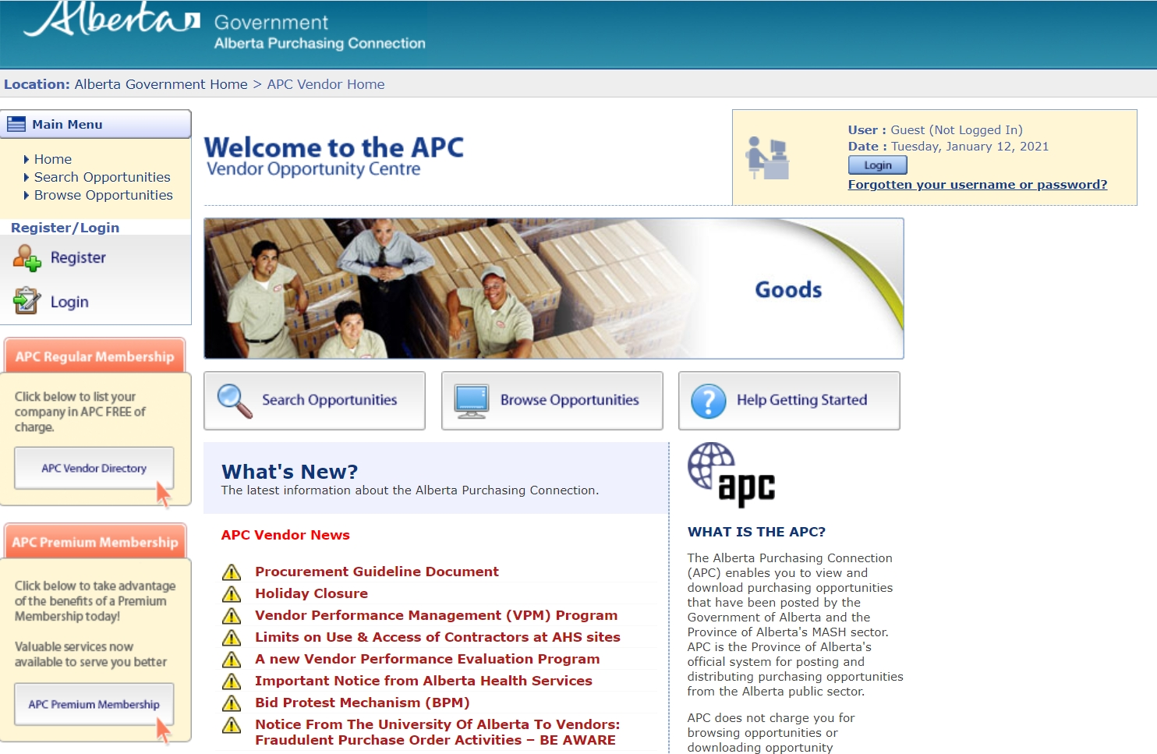

Slide 18
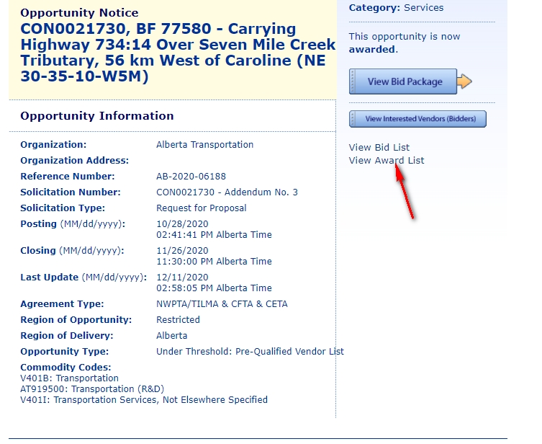

Slide 19
The Where is Changing

Slide 20
Use this divider slide to break your presentation into manageable parts.
Say hello to the future of
Supply Chain Management

Slide 22
Setting Your Business up for Success To Do Business with the
Government of AB

Slide 23
What Can You Do?
Download all of the documents, including any updates resulting from supplier questions and answers
Read them all before preparing your response – paying careful attention to all mandatory provisions
If you have a question contact the procurement officer listed before closing date
Don’t wait until the last moment
If you are unsuccessful in an opportunity - ask for a debrief to understand where you can improve next time

Slide 24
Need Help…
We are here for you!
Phone: 780 427-4111
Email: corporate.purchasing@gov.ab.ca
APC: http://www.purchasingconnection.ca
Ariba Discovery: https://service.ariba.com/Discovery.aw/ad/quoteSearch

Slide 25
Questions?

